Slide 1
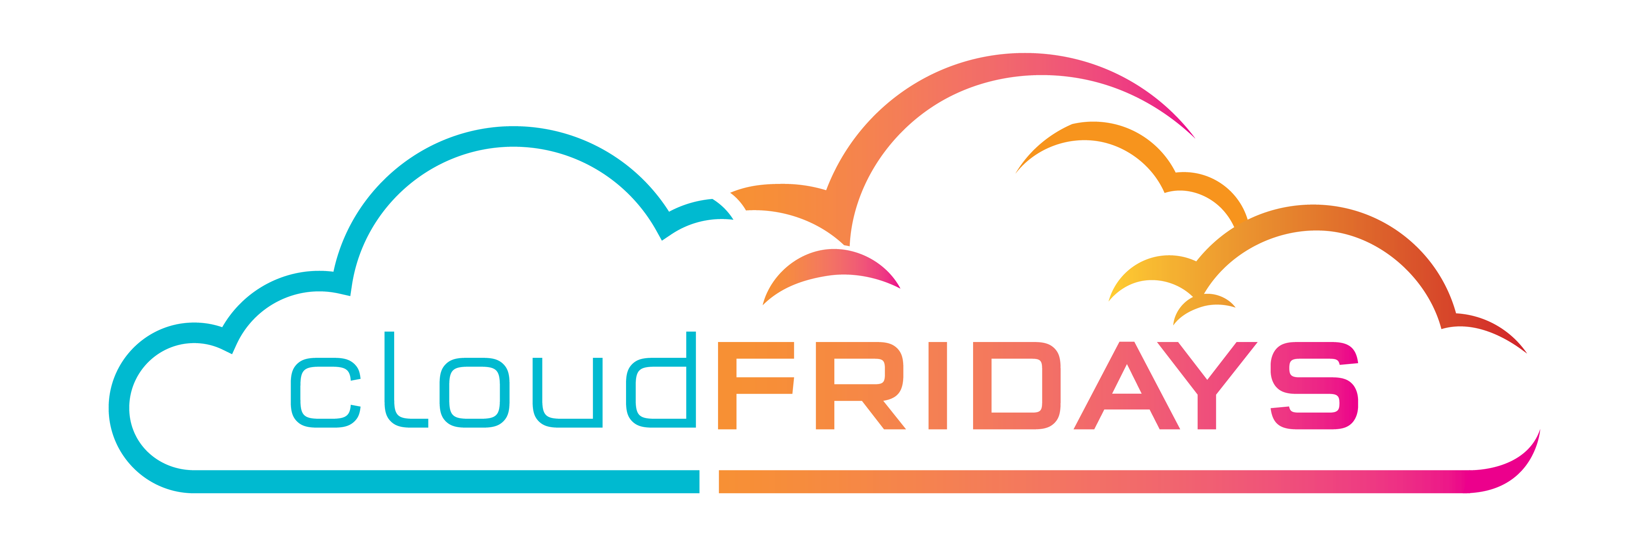

The Benefits and considerations of using cloud services
Nicolas Blank
Alistair Pugin

Slide 2

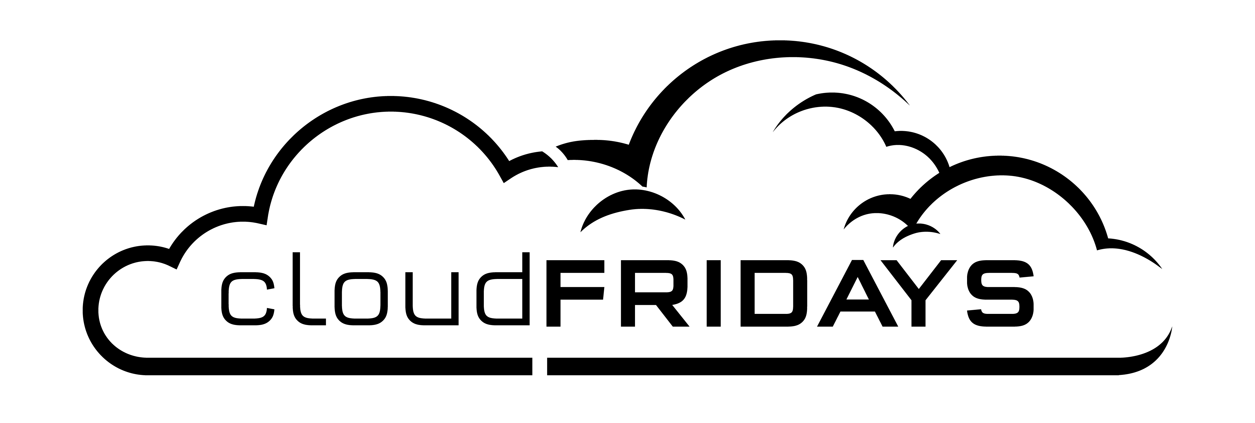
Agenda
Define : Cloud Computing, High Availability, Scalability, Elasticity, Agility, Fault Tolerance, and Disaster Recovery
Understand the principles of economies of scale
Capital Expenditure (CapEx) vs Operational Expenditure (OpEx)
Understand the consumption-based model

Slide 3

Define: Cloud computing
Cloud computing is the delivery of computing services—servers, storage, databases, networking, software, analytics, intelligence and more—over the internet (the cloud), enabling faster innovation, flexible resources, and economies of scale.
You typically pay only for cloud services you use, helping lower your operating costs, run your infrastructure more efficiently, and scale as your business needs change.

Slide 4
Define: High Availability
Redundancy of components within a system, which allows the system as a whole to suffer the failure of one ore more component pieces, WINTHIN a geography
HA is an IT system level event
Tends to be transparent

Slide 5
Define: Disaster Recovery
Redundancy of components within a system, which allows the system as a whole to suffer the failure of one ore more component pieces, between geographies.
DR – is a business level Event

Slide 6
Define: Scalability
The ability to increase or decrease resources for any given workload. You can add additional resources to service a workload (known as scaling out), or add additional capabilities to manage an increase in demand to the existing resource (known as scaling up). Scalability doesn't have to be done automatically

Slide 7


Define: Elasticity
The ability to automatically or dynamically increase or decrease resources as needed. Elastic resources match the current needs, and resources are added or removed automatically to meet future needs when it’s needed, and from the most advantageous geographic location. A distinction between scalability and elasticity is that elasticity is done automatically

Slide 8
Define: Agility
The ability to react quickly. Cloud services can allocate and deallocate resources quickly. They are provided on-demand via self-service, so vast amounts of computing resources can be provisioned in minutes. There is no manual intervention in provisioning or deprovisioning services.

Slide 9
Capex Vs Opex
CapEx is the spending of money on physical infrastructure up front, and then deducting that expense from your tax bill over time. CapEx is an upfront cost, which has a value that reduces over time.
OpEx is spending money on services or products now and being billed for them now. You can deduct this expense from your tax bill in the same year. There is no upfront cost, you pay for a service or product as you use it.

Slide 10
CapEx computing costs
Server
Storage
Networking
Backup
Archive
DR
Datacenter costs
Technical personnel costs

Slide 11
OpEx Cloud Computing Costs
Licensing Software and systems
On demand scaling charges
Per user or per Org billing

Slide 12
CapEx Benefits
Planned expenses at the beginning of a project / cycle
Fixed costs
Fixed budget

Slide 13
Benefits of OpEx
No upfront investment
On-Demand Spend for infrastructure
Spend model for unknown or variable demand

Slide 14
Benefits of Opex
Notes:
Demand and growth can be unpredictable and can outpace expectation, which is a challenge for the CapEx model as shown in the graph.
With the OpEx model, companies wanting to try a new product or service don't need to invest in equipment. Instead, they pay as much or as little for the infrastructure as required.
OpEx is particularly appealing if the demand fluctuates or is unknown. Cloud services are often said to be agile. Cloud agility is the ability to rapidly change an IT infrastructure to adapt to the evolving needs of the business. For example, if your service peaks one month, you can scale to demand and pay a larger bill for the month. If the following month the demand drops, you can reduce the used resources and be charged less. This agility lets you manage your costs dynamically, optimizing spending as requirements change.

Slide 15

Economies of Scale
The ability to do things cheaper and more efficient at scale
Cloud providers have MASSIVE scale and are able to pass that economic benefit onto customers
Storage is an example – cost per TB in cloud vs on-premises

Slide 16
Consumption based model
Used by Cloud Service Providers
Users pay only for resource usage
No upfront costs
No infrastructure purchase
No need to scale for maximum periods, e.g. month ends, years ends

Slide 17
Cloud Deployment Models
Public
Private
Hybrid

